Slide 1
DAPP-DAWG Connections
Dairy for People and the Planet (DAPP)
Naomi Fukagawa, Beltsville Human Nutrition Research Center
Dairy Agroecosystems Working Group (DAWG)
Peter Vadas, ONP Land & Air Management

Slide 2
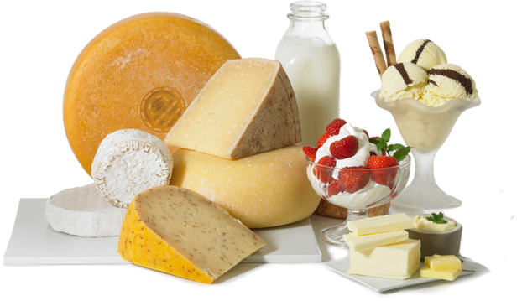
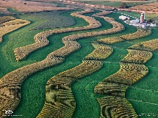
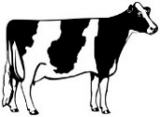
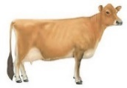
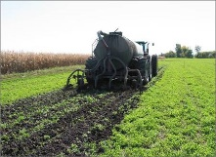
Figure 2: The Dairy Grand Challenge Project (DAPP) Illustrated – A Discover Model for Integrated Dairy Systems
Global Objectives
Develop sustainable dairy food production systems that improve human health and well-being.
Understand the GEM(S) iterative relationships among soils, forages, cows and dairy products.
Improve the productivity, efficiency, and sustainability of dairy systems on a landscape scale.
Identify system inefficiencies (leaks) and develop multi-disciplinary research based strategies to address them.
Determine how public health related to dairy is influenced by integrated dairy production systems.
Dairy product research
Nutritional value of milk for human health
Novel milk products
Economic value of milk products on-farm
Externalities
climate change, land price, competition, regulation , water limitations, energy costs
Leaks
forage loss, feed quality, metabolic loss, forage & cow production, efficiency
Leaks
nutritional value of milk, human health, novel products, consumer demand
Better cows
Better milk
Forage research
Forage systems that protect and enhance ecosystems
Forage breeding, production and management to optimize cow performance and efficiency
Economic values for ecosystem services provided by forages
Better forages
Better cows
Dairy cow research
Milk production and quality
Feed and production efficiency
Nutritional value of milk
Animal health and well-being
Manure management/recycling
Sustainable Dairy Production Systems for Human Health and Well-being
Externalities
climate change, weather, competition, regulation, nutrient availability, public demand, water limitations
Better soils
Better forages
Better cows
Better soils
Externalities
climate change, competition, regulation, consumer demand
Leaks
soil erosion, organic C and nutrients losses; air & water quality; GHG emissions
Leaks
soil health, nutrient loss, water quality, pathogens, odors, GHG emissions
Soil health/ecology research
Soil health and resilience, soil carbon
Nutrient cycling, N and P retention and utility
Soil erosion and water quality
Understanding the challenges & opportunities for dairy production systems research.
Photo credit: CA Milk Marketing Board, National Geographic.

Slide 3
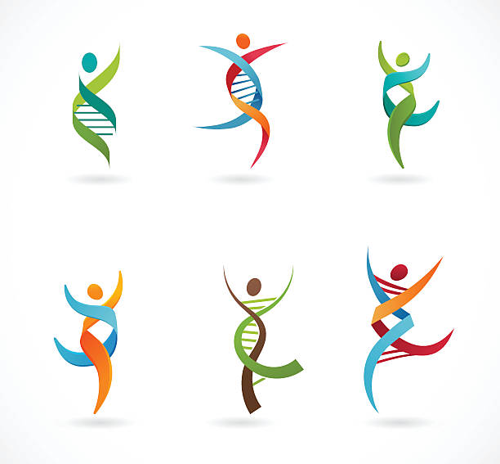
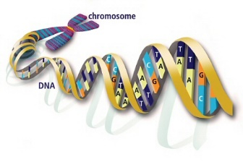
Figure 4: The Dairy Grand Challenge Project (DAPP) Illustrated – A “Systems Biology” Model for Integrated Dairy Systems
Global Objectives
Develop sustainable dairy food production systems that improve human health and well-being.
Understand the GEM(S) iterative relationships among soils, forages, cows and dairy products.
Improve the productivity, efficiency, and sustainability of dairy systems on a landscape scale.
Identify system inefficiencies (leaks) and develop multi-disciplinary research based strategies to address them.
Determine how public health related to dairy is influenced by integrated dairy production systems.
Dairy – consumer ecology interface
Human genotype (gene expression) by dairy product interactions
Human microbiome interactions with dairy products and human health
Human socio-economic demands for dairy production
Forage genetic and microbiome influences
Dairy cow genetic and microbiome influences
Human genetic, health, microbiome and nutritional ecology influences
Forage – dairy systems ecology interface
Forage genetic by dairy cow interactions
Forage microbiome influence on forage quality, soil health, and the dairy cow
Dairy cow forage digestibility and microbiome influences
The Living Ecology of Sustainable Dairy Systems
Follow the DNA!
Dairy cow – systems ecology interface
Dairy cow genotype and gene expression by production system interactions
Rumen and gut microbiome by production system interactions and adaptation
Dairy cow health and well-being by environmental microbiome interactions
Forage genetic, health and microbiome influences
Soil microbial and
pathogen parasite influences
Dairy cow manure microbiome influences
Soil microbiome influences
Soil health – systems ecology interface
Soil microbiome influence on forage health, production & quality
Soil microbial genetics influence on soil health, parasites, pathogens and nutrient cycling efficiency
Soil microbiome by dairy manure nutrient and microbiome interactions
Understanding the systems biology or “living ecology” of dairy production systems.
Photo credit: National Geographic.

Slide 4
DAPP Experiments 2018-2020
Experiment 1: Link feeding studies to milk composition (2018-present); Part of an experiment designed to evaluate whether cows maintain their efficiency when switching from a high starch diet to a high fiber diet (and vice versa). Milk samples were collected from 62 cows and sent to nutrition labs for composition analysis.
Experiment 2: Determine the effect of forage type on production, milk composition, and nutrient utilization in Jersey’s and Holstein’s.
Experiment 3 (planned): Soil, weather, field management effects on forages and then on cows and on milk profiles.

Slide 5
Other Potential Synergies
New ARS Unit co-located in Vermont
Manure Priming/Manure Sheds
Carbon Sequestration
Water quality & availability

Slide 7

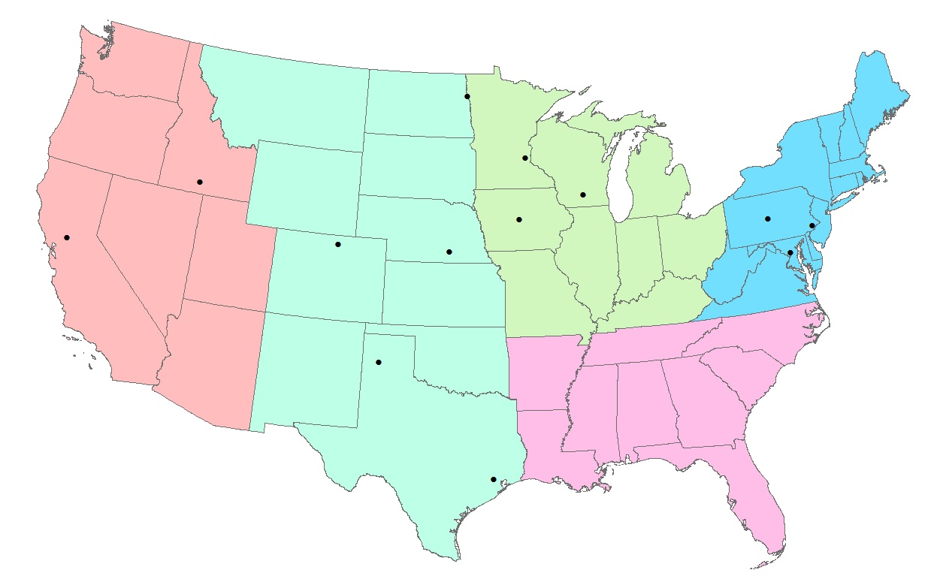
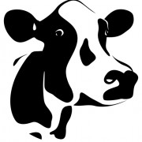
Figure 1A: The Dairy Grand Challenge Project (DAPP) Illustrated – Participant Map and Research Focus
Dairy for People & the Planet DAPP Research Sites
St. Paul (SWMR/PSR)
Soils, Forages
Madison (USDFRC)
Dairy Nutrition, Genetics, Microbiome, Soils, Forages
Grand Forks (GFHNRC)
Human Nutrition
Kimberly (NWISRL)
Soils, Air and Water
Clay Center (USMARC)
Microbiome, Nutrition, Soils
University Park (PSWMR) Soils, Forages, LTAR
Ames (NLAE)
Soils, Water, LTAR
Davis (WHNRC)
Human Nutrition
Fort Collins (SMSBR)
Soils, Air and Water, NUOnet
Beltsville (AGIL)
Dairy Genetics, Nutrition
Wyndmoor (ERRC)
Human Nutrition, Food Safety
Bushland (CPRL)
Soils, Air and Water
Beltsville (BHNRC)
Human Nutrition
Houston (CNRC)
Human Nutrition
Photo credit: CA Milk Marketing Board

